Slide 1
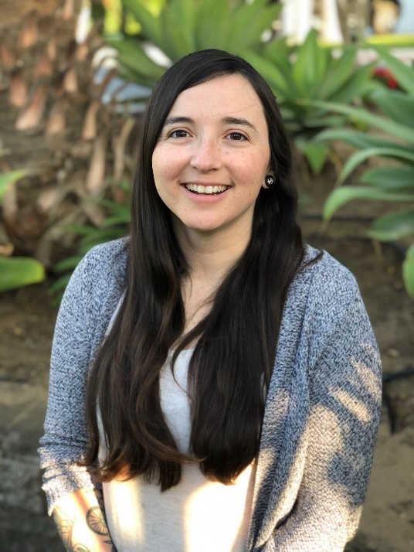
Erica Andrade serves as the Family Advocate at Mesa Middle School and Judkins Middle School.
She works closely with School Counselors, the Friday Night Live Team, Oceano Family Resource Center and 5 Cities Homeless Coalition so families basic needs are addressed quickly.
Erica helps parents develop an understanding of their Middle School child’s social and emotional needs. She supports students so they are engaged with school and enrichment activities such as sports, music and art programs.

Slide 2
A family of three experiencing financial hardships due to father and mother being becoming unemployed due to COVID-19. They are both undocumented and need assistance with their utilities. They require $250.
An undocumented mother of three lost her job due to COVID-19. My clients sister and daughter have moved in due to domestic violence. This family requires rental assistance and a baby swing.

Slide 3
A family of three experiencing financial hardships due to father and mother being becoming unemployed due to COVID-19. They work in the hotel industry and both are undocumented and need financial assistance with their utilities. They require $250.
Family in need of a dependable computer. Student relies on access to TeleHealth for his mental health treatment sessions. Single Mother is undocumented and unemployed. The computer is purchased from Exploration Station in Grover Beach and costs $300.

